Slide 1
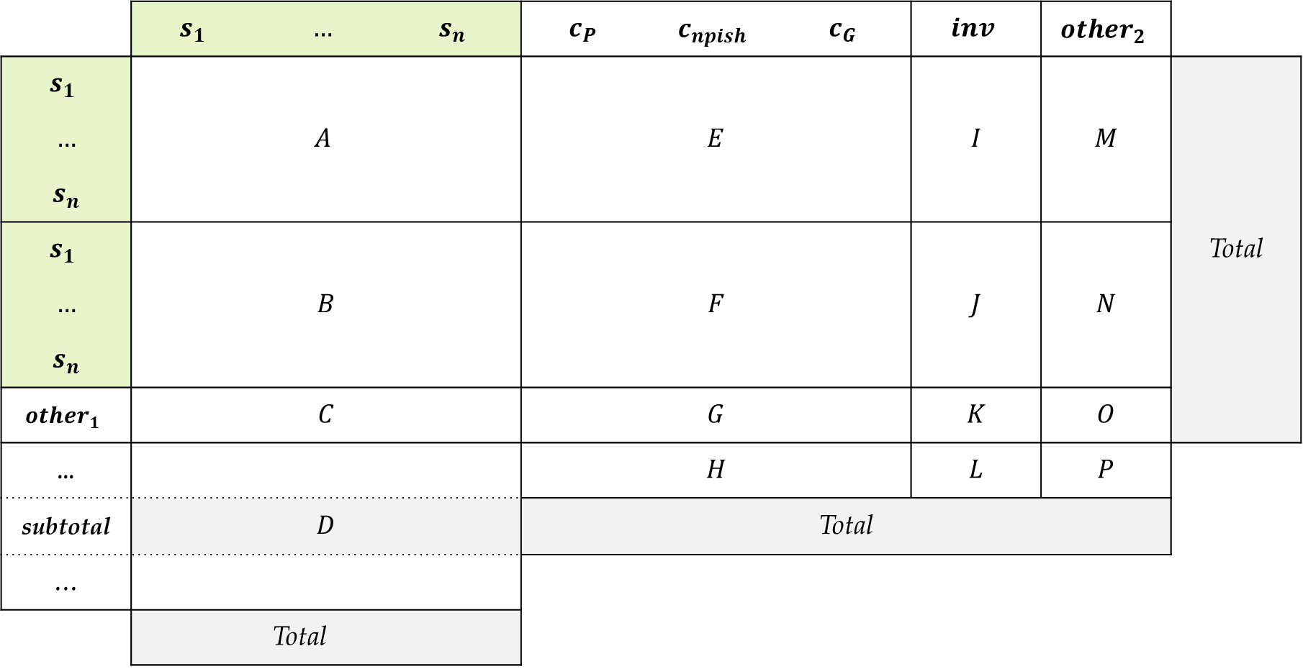
IO, values:
Input
consumption
 | $$s_{1}$$ | $$…$$ | $$s_{n}$$ | $$c_{P}$$ | $$c_{npish}$$ | $$c_{G}$$ | $$inv$$ | $${other}_{2}$$
$$s_{1}$$ | $$A$$ |  |  | $$E$$ |  |  | $$I$$ | $$M$$ | Total
$$…$$
$$s_{n}$$
$$s_{1}$$ | $$B$$ |  |  | $$F$$ |  |  | $$J$$ | $$N$$
$$…$$
$$s_{n}$$
$${other}_{1}$$ | $$C$$ |  |  | $$G$$ |  |  | $$K$$ | $$O$$
... |  |  |  | $$H$$ |  |  | $$L$$ | $$P$$
subtotal | $$D$$ |  |  | Total
…
 |  | Total
Production
Import
Pr. Inputs

Slide 2
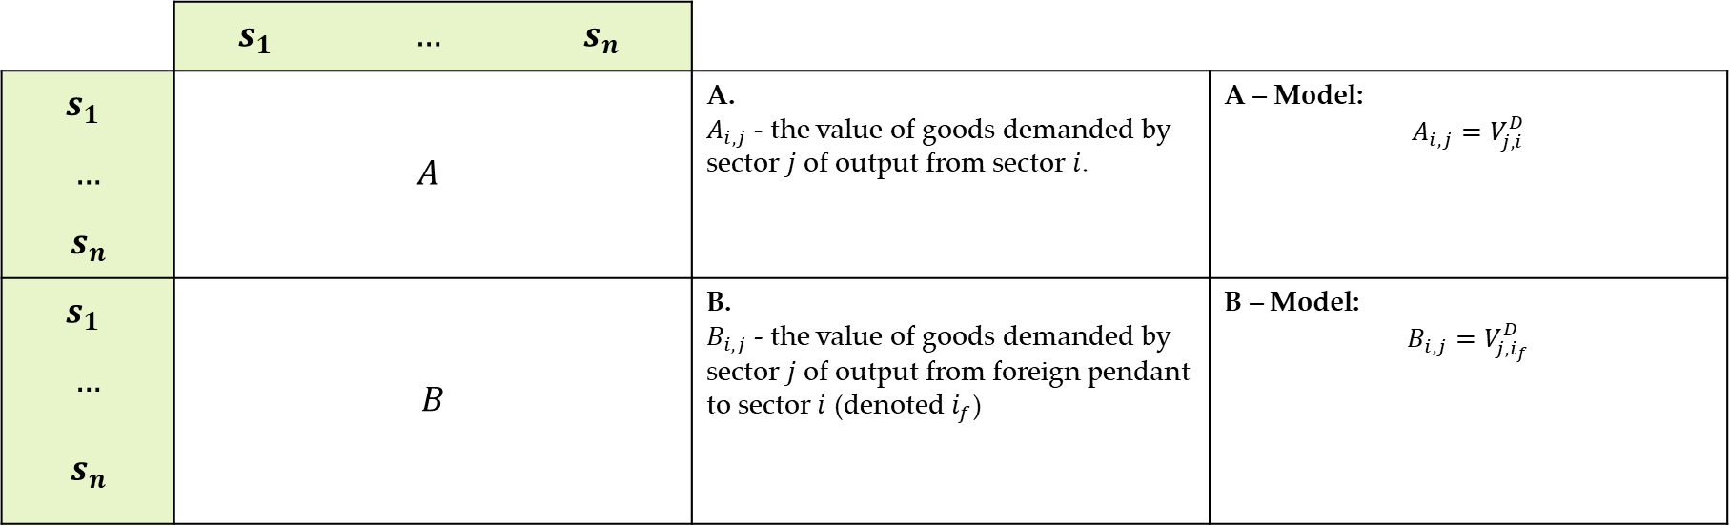
A-B: Domestic production
Input
 | $$s_{1}$$ | $$…$$ | $$s_{n}$$
$$s_{1}$$ | $$A$$ |  |  | A. $A_{i,j}$ - the value of goods demanded by sector $j$ of output from sector $i$. |  |  | A – Model: $$A_{i,j}=V_{j,i}^{D}$$
$$…$$
$$s_{n}$$
$$s_{1}$$ | $$B$$ |  |  | B. $B_{i,j}$ - the value of goods demanded by sector $j$ of output from foreign pendant to sector $i$ (denoted $i_{f}$) |  |  | B – Model: $$B_{i,j}=V_{j,i_{f}}^{D}$$
$$…$$
$$s_{n}$$
Production
Import

Slide 3
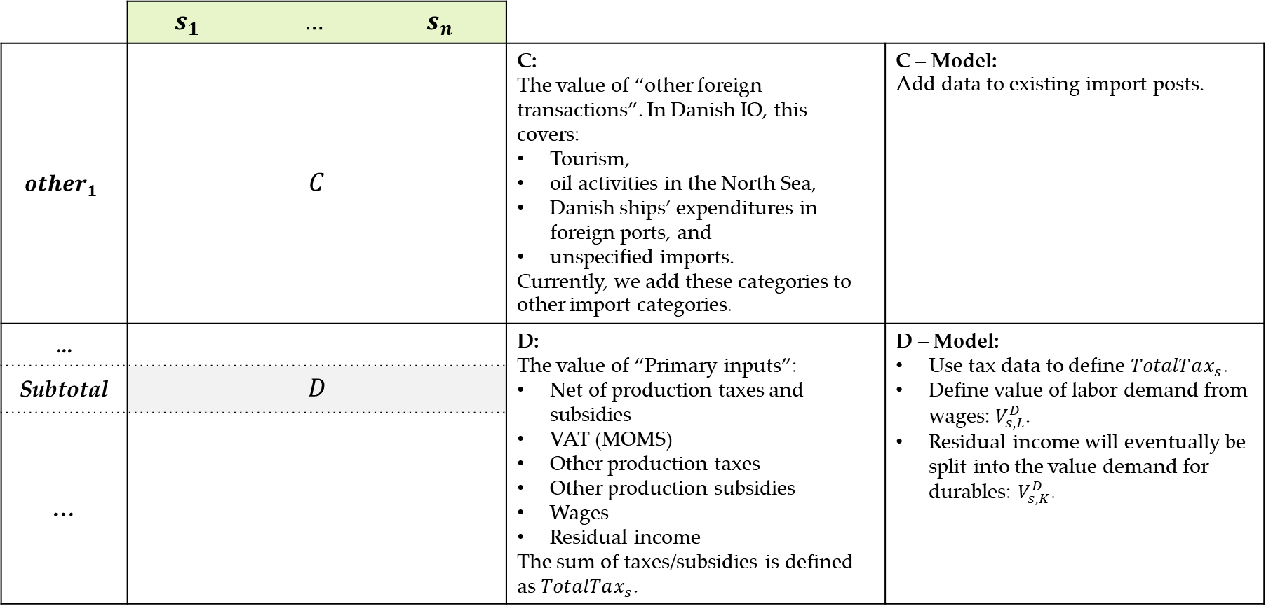
C-D: Other imports, wages, and tax (more ad-hoc)
Input
 | $$s_{1}$$ | $$…$$ | $$s_{n}$$
$${other}_{1}$$ | $$C$$ |  |  | C: The value of “other foreign transactions”. In Danish IO, this covers: Tourism, oil activities in the North Sea, Danish ships’ expenditures in foreign ports, and unspecified imports. Currently, we add these categories to other import categories. |  |  | C – Model: Add data to existing import posts.
... |  |  |  | D: The value of “Primary inputs”: Net of production taxes and subsidies VAT (MOMS) Other production taxes Other production subsidies Wages Residual income The sum of taxes/subsidies is defined as $TotalTax_{s}$. |  |  | D – Model: Use tax data to define $TotalTax_{s}$. Define value of labor demand from wages: $V_{s,L}^{D}$. Residual income will eventually be split into the value demand for durables: $V_{s,K}^{D}$.
Subtotal | $$D$$
…
Primary Inputs

Slide 4
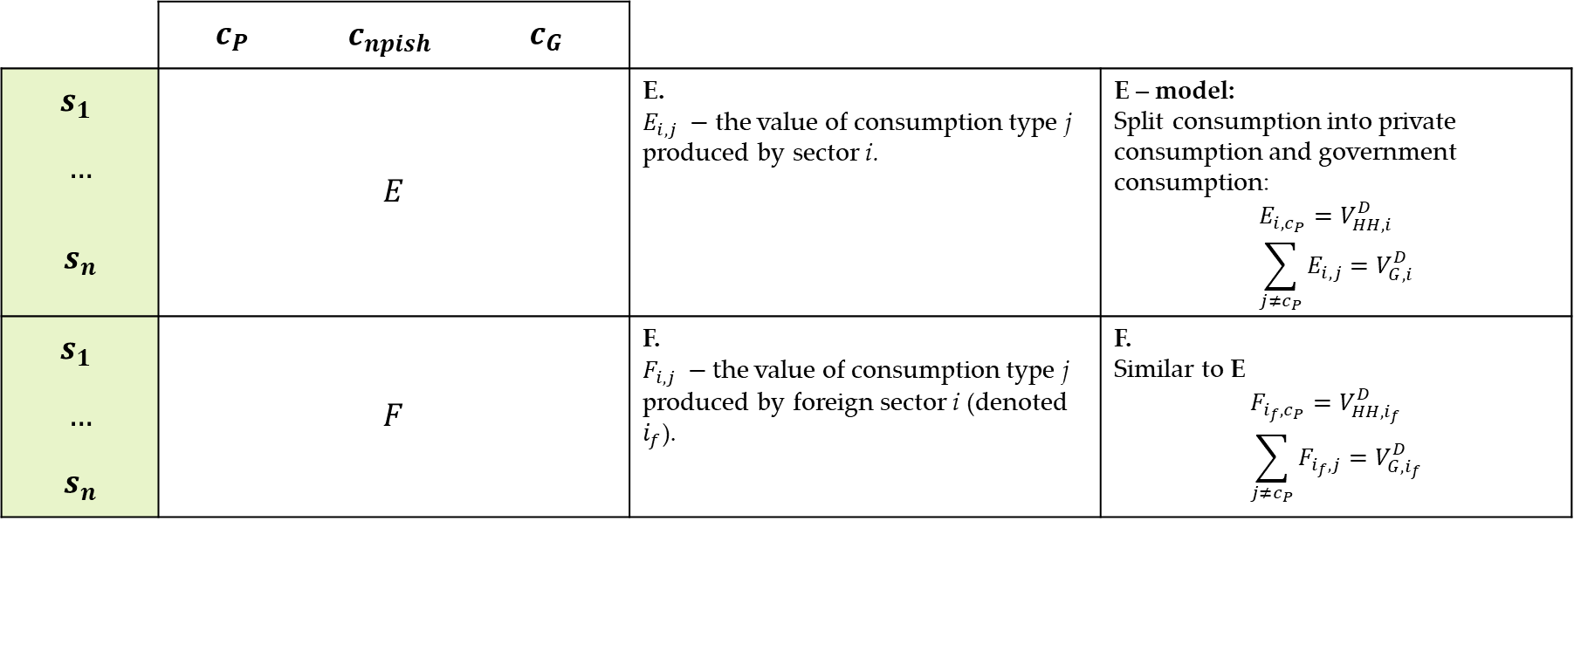
E-F: Consumption split
consumption
 | $$c_{P}$$ | $$c_{npish}$$ | $$c_{G}$$
$$s_{1}$$ | $$E$$ |  |  | E. $E_{i,j} −$ the value of consumption type j produced by sector i. |  | E – model: Split consumption into private consumption and government consumption: $$E_{i,c_{P}}=V_{HH, i}^{D} \\ \sum_{j≠c_{P}}{E_{i,j}}=V_{G,i}^{D}$$
$$…$$
$$s_{n}$$
$$s_{1}$$ | $$F$$ |  |  | F. $F_{i,j} −t$he value of consumption type j produced by foreign sector i (denoted $i_{f}$). |  | F. Similar to E $$F_{i_{f},c_{P}}=V_{HH, i_{f}}^{D} \\ \sum_{j≠c_{P}}{F_{i_{f},j}}=V_{G,i_{f}}^{D}$$
$$…$$
$$s_{n}$$
Production
Import

Slide 5
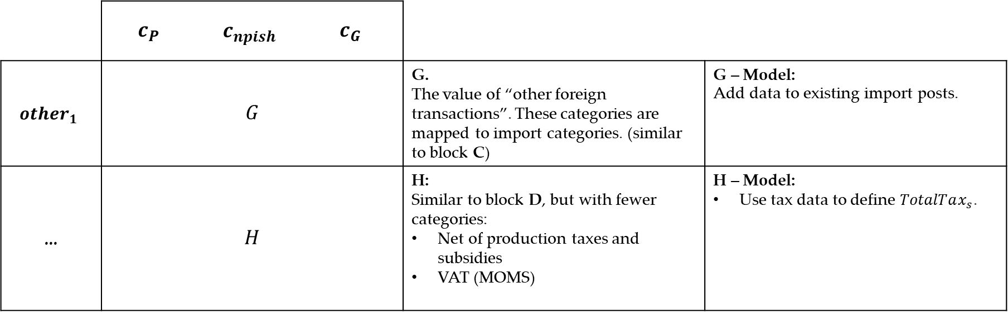
IO, values:
consumption
 | $$c_{P}$$ | $$c_{npish}$$ | $$c_{G}$$
$${other}_{1}$$ | $$G$$ |  |  | G. The value of “other foreign transactions”. These categories are mapped to import categories. (similar to block C) |  |  | G – Model: Add data to existing import posts.
... | $$H$$ |  |  | H: Similar to block D, but with fewer categories: Net of production taxes and subsidies VAT (MOMS) |  |  | H – Model: Use tax data to define $TotalTax_{s}$.
Pr. Inputs

